Slide 1
Interaction Design for
Product Service System
Prof. Francesca Rizzo

Slide 2
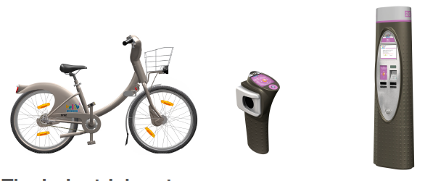

What is Interaction Design for Product Service System
What are the experiences people have with interactive products? How are they designed?
And what does it make them more or less successful?
Interaction design is that area of the design discipline that aims at creating effective and compelling interactive experiences for subjects interacting with products and service systems enhanced by digital technologies.

Slide 3
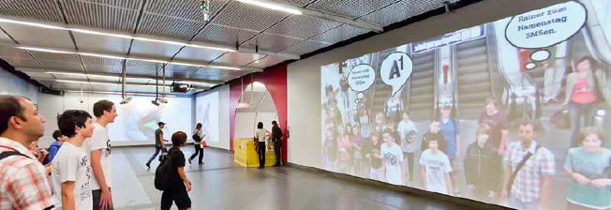
The aim of the course
The course will introduce the student to the basis of interaction design from the perspective that designing for interaction involves multi-disciplinary teams engaged in the planning, conception, design, implementation, and support of products, services, and systems that meet human needs and desires.

Slide 4
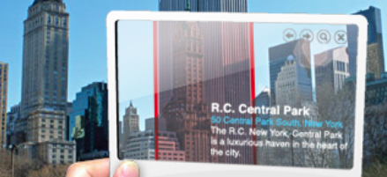
The structure of the course
The presentation of the main components that characterises the area of the interaction design (lectures)
The the application of some of the concepts and tools presented in the first area on a specific domain of application: the design for humanistic smart city (assignments)
Rather than just focusing on the installation and control of network hardware, city governments, technology companies and their urban-planning advisers can exploit a more ground-up approach to creating smarter cities in which people become the agents of change (C. Ratti, 2011).

