Slide 1
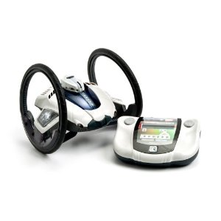

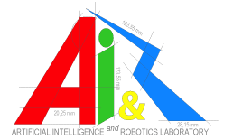

Interdisciplinary course of
Robotics and Design cod. 093836
Theme for this year:
Designing robots for games
Designing interesting robots: shape, movement, behaviour
Designing the interaction among robots and human players

Slide 2
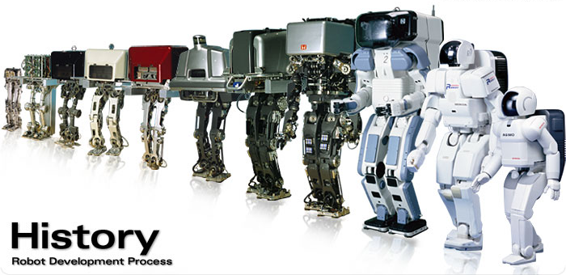
- Why for designers?
- We will must be ready to participate in the development process of the next generation of “products”. Otherwise, you may come to design just another “new” chair ;-)
Notes:
Asimo – honda
With the goal of participate from the starting point of the process with a recognised role. Not to arrive at the end of the process, when almost everything is decided, in order to do it more beautiful.

Slide 3
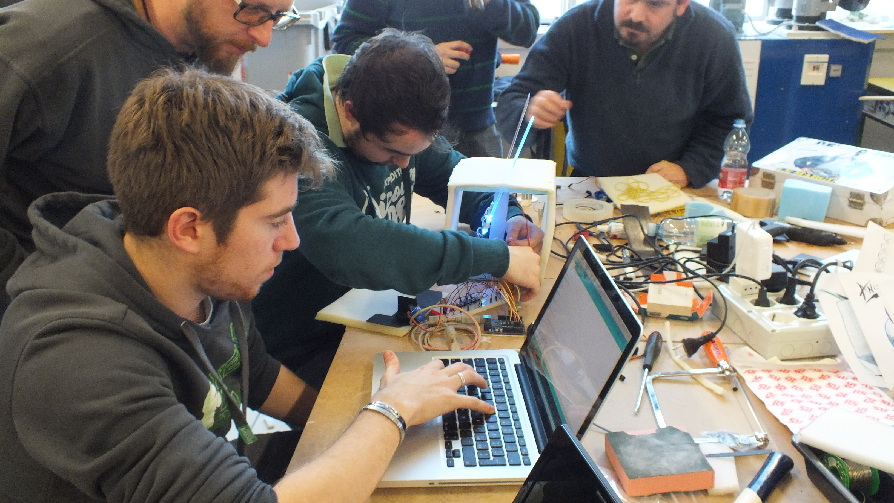
How it is possible?
Working hands-on in a mixed group (2 designers + 2 engineers), learning-by-doing together with people with different backgrounds.
Supported by PhyCo Lab, AirLab and Laboratorio di modelli e prototipi

Slide 4
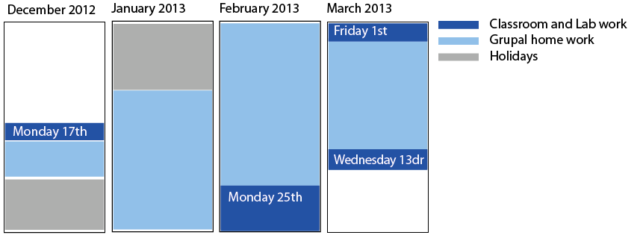
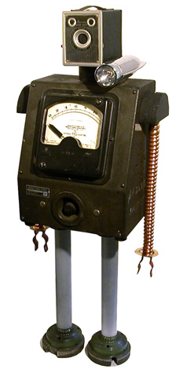
We offer you:
Some credits, a lot of fun and the possibility of learning by doing together from our experience and from the knowledge of other people like you.
You must bring:
Passion for your work, curiosity, and pleasure for share knowledge and work intensively in group. Each group may need to spend some money (approx €100) to buy electronic components and prototyping material, but we are working to find sponsors, as well as opportunities to show your work at exhibitions

